Slide 1
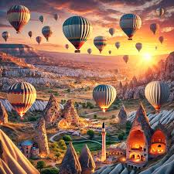
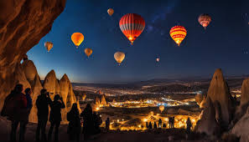
TRAVEL PACK

Slide 2
Table of Contents
INTRODUCTION ENTRY/EXIT REQUIREMENTS ETIQUITTE AND CULTURAL EXPETATTIONS EVENT INFORMATION BUDGET TRAVEL ITINERARY

Slide 3
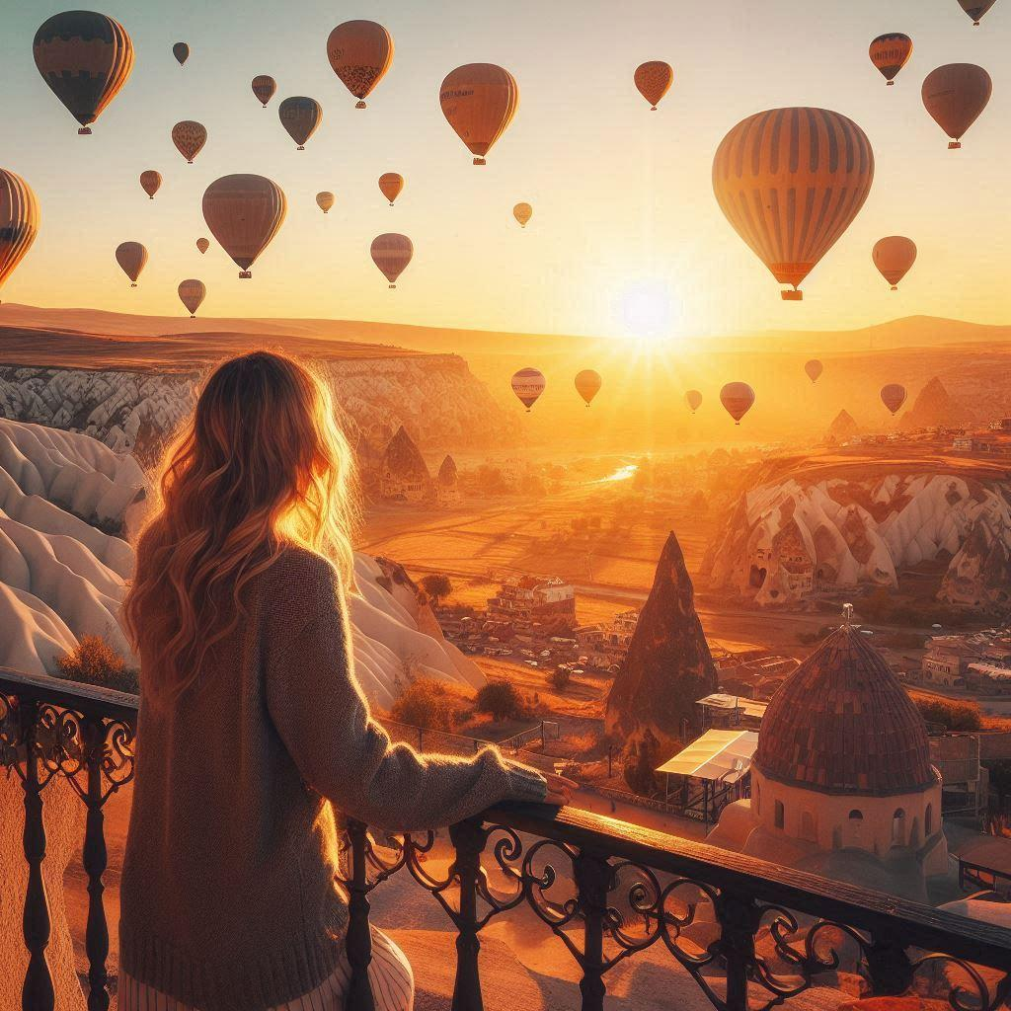
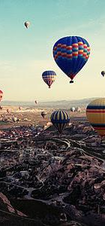
INTRODUCTION
Sindiwe Rana
Cappadocia,Turkey
NOV 1 - NOV 4 2024
A 3 days and 3 nights vacation to the beautiful country and rich on history. A dream destination for adventure seekers and history buffs alike. Cappadocia's distinctive rock formations, known as fairy chimneys, are a sight to behold. Explore ancient underground cities, Byzantine churches, and historic cast. Enjoy hot air ballooning, hiking, horseback riding, and ATV tours. Immerse yourself in Turkish culture with traditional cuisine, music, and handicrafts.

Slide 4
Entry/Exit Requirements

Slide 5
Documentation Requirements
ENTRY :
Passport :valid for at least six months from the date of your departure from Turkey.
E-visa
EXIT:
No specific exit requirements .
SOURCES
https://www.evisa.gov.tr/
https://www.smartraveller.gov.au/destinations/europe/turkiye

Slide 6
Etiquette and Cultural Expectations

Slide 7
DO’S
Dress modestly: when visiting religious sites or conservative areas.
Greet with respect: A firm handshake and eye contact are common greetings.
DON'TS
Don't be overly loud or boisterous: Respect the peaceful atmosphere of Cappadocia, especially in historic areas.
Don't photograph people without permission: It's considered impolite to photograph people without their consent.

Slide 8
Event Information

Slide 9
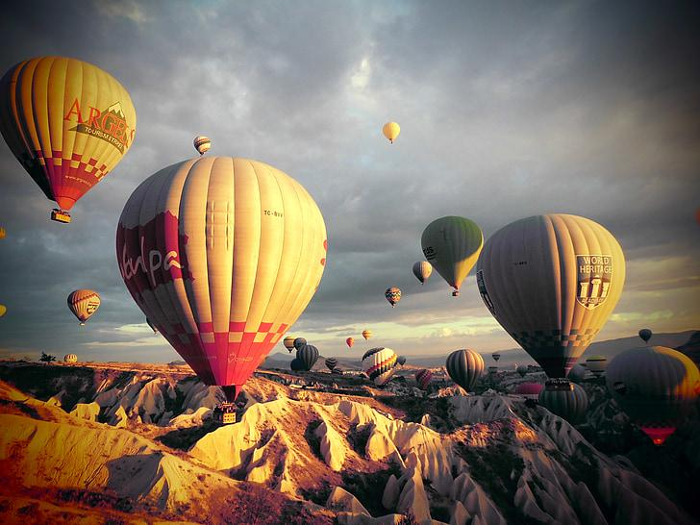
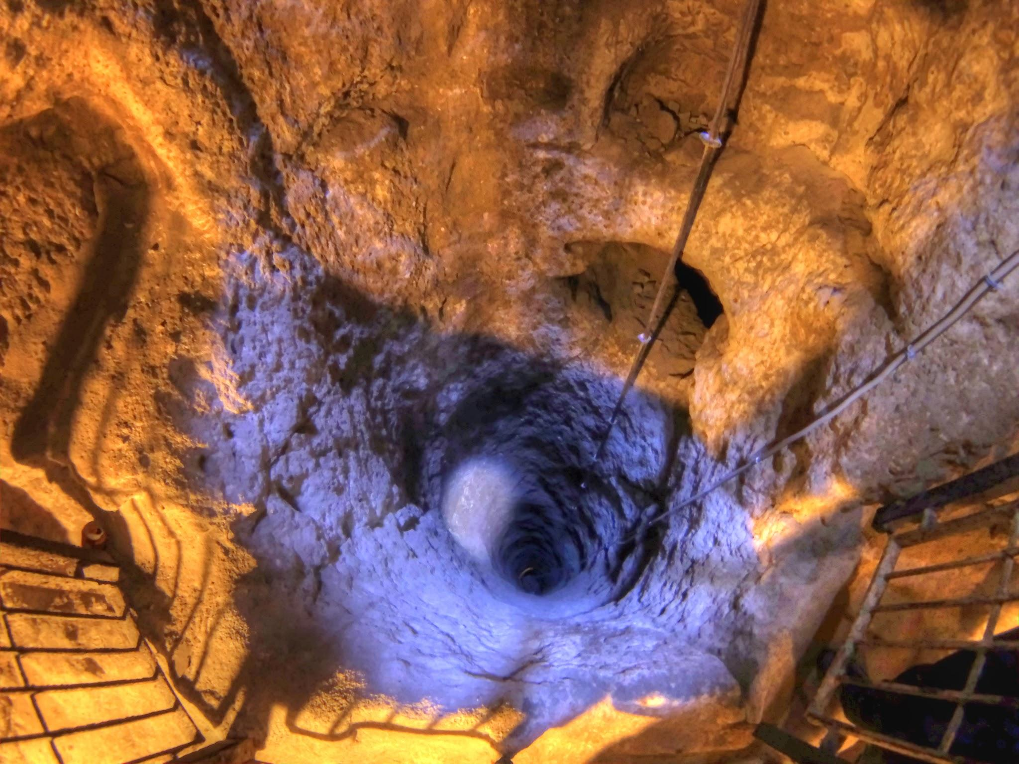
ACTIVITIES TO DO :
Hot air balloon ride at sunrise.
Hiking through the fairy chimneys.
Underground City Tour to discover the fascinating history of Cappadocia.

Slide 10
Budget

Slide 11

Budget
ITEMS | AMOUNT
Visa application process | $59.00
Flights | $1,071.00
Accommodation | $537.00
Activities | $258.00
Meals | $300.00
Car rental | $107.00
Total cost | $2,332.00

Slide 12
Travel Itinerary

Slide 13

DEPARTING FLIGHT
Date | Depart - Location | Depart - Time | Airline | Confirm # | Flight # | Arrival - Location | Arrival - Time | More Info
1/11/2024 | Johannesburg OR Tambo | 19:05 | Turkish |  | A350-900 | Istanbul Airport | 06:20 | Stop at Istanbul airport at 6:20am
2/11/2024 | Istanbul Airport | 09:20 | Turkish |  | A321 | Nevsehir Cappadocia | 10:35 | Fly to Nevsehir Cappadocia at 9:20am
RETURNING FLIGHT
Date | Depart - Location | Depart - Time | Airline | Confirm # | Flight # | Arrival - Location | Arrival - Time | More Info
04 Nov 2024 | Nevsehir Cappadocia | 21:40 | Turkish |  | 737-900 | Istanbul Airport | 11:10 | Stop at Istanbul airport at 11:10pm
5/11/2024 | Istanbul Airport | 02:00 | Turkish |  | A350-900 | Johannesburg O.R Tambo Intl | 10:55 | Fly to Johannesburg O.R Tambo at 2:00am

Slide 14
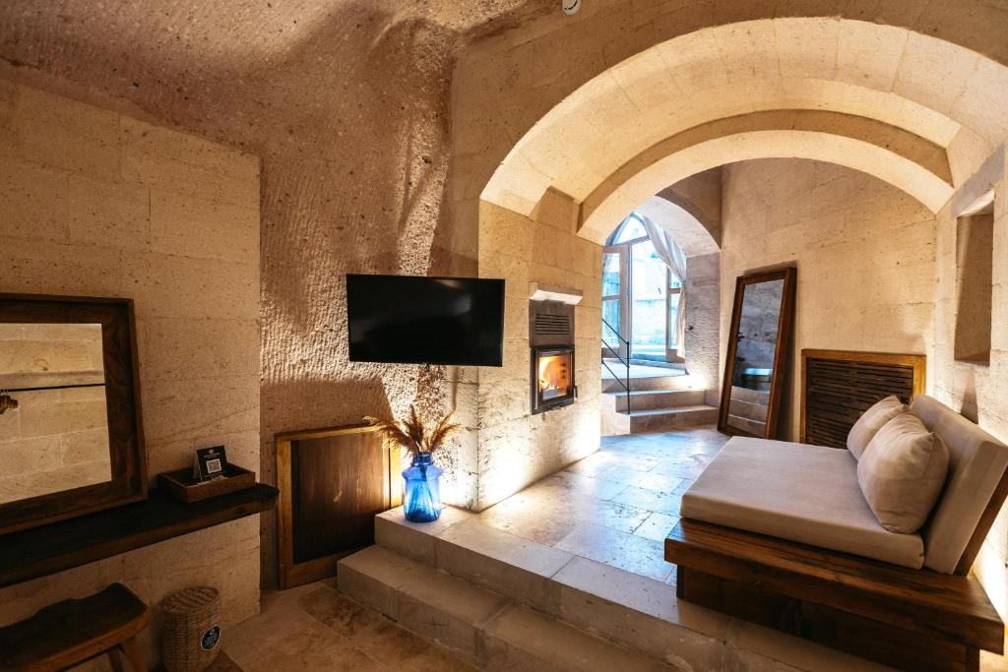
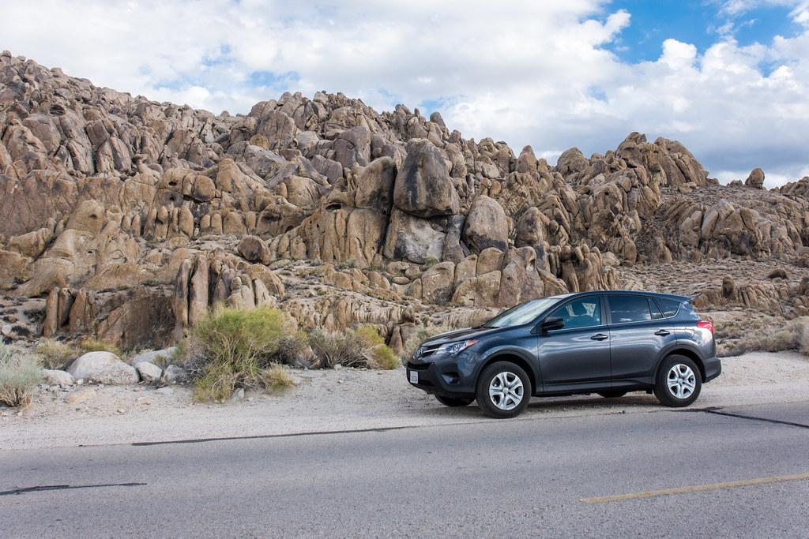
GROUND TRANSPORT AT DESTINATION
Date | Company | Type of Transport | Meet Up Point | Confirm # | Pick-Up Time | Return Date | Return Time | More Info
2/11/2024 | Alamo | Car | Nevsehir turkey airport |  | 11:00 | 4/11/2024 | 20:00
HOTEL
Date | Name | Street | City | Confirm # | Room | Check-In Time | Check-Out Time | More Info
2/11/2024 | Millstone cave suites | Adnan Menderes Cd | Uchisar |  | Suite with view | 14:00 | 12:00
4/11/2024 | Millstone cave suites | Adnan Menderes Cd | Uchisar |  | Suite with view | 14:00 | 12:00

Slide 15
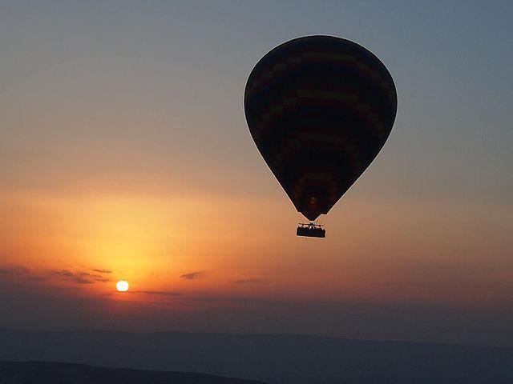
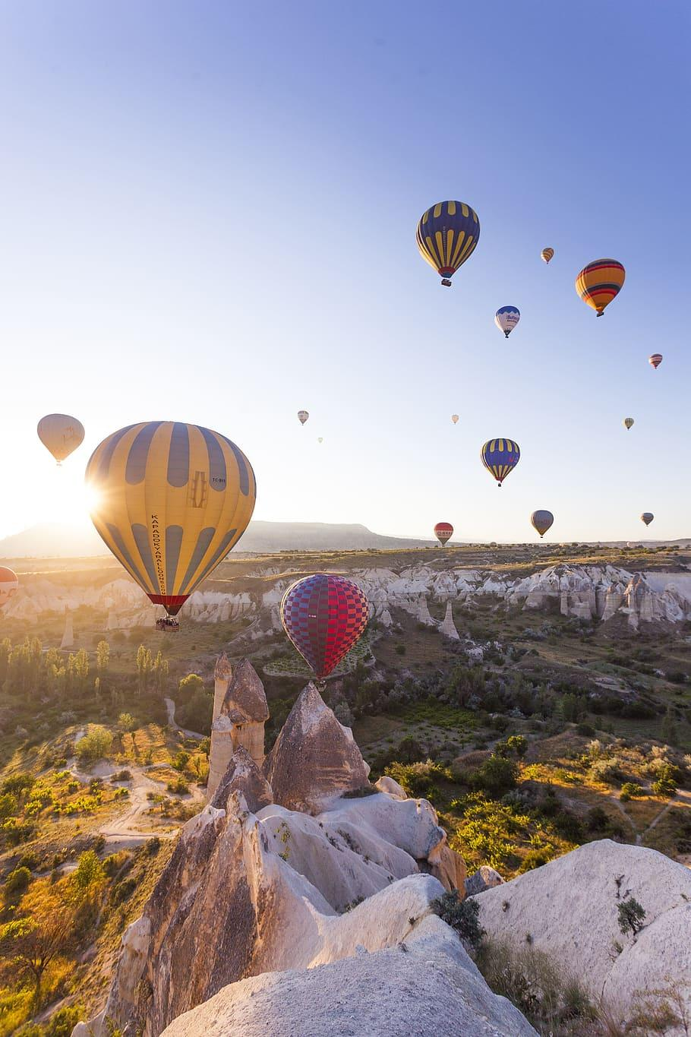
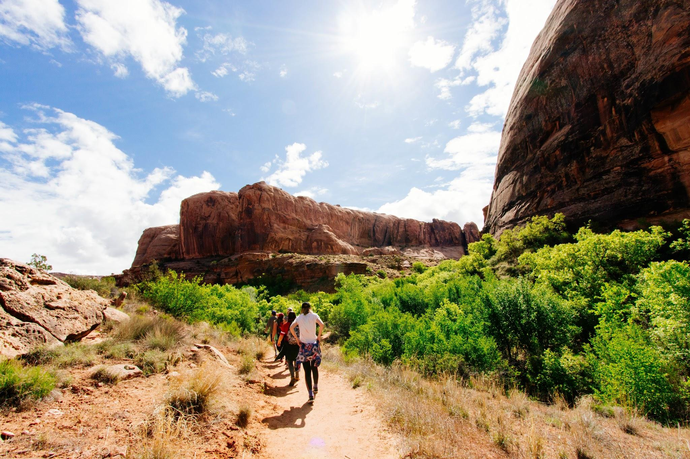
 | EVENTS
 | Date | Venue | Street | City | Contact Person | Topic | Start Time | End Time | More Info
 | 2/11/2024 | Fairy Chimneys cappadocia | D302 | Uchisar |  | Hot air balloon | 16:00 | 17:00
 | 3/11/2024 | Pigeon valley | D302 | Gerome |  | Hiking trail | 09:00 | 14:00

